Slide 1
Causal Inference in Epidemiology
Themba G. Ginindza, PhD, MPH, MSc-Epi
Professor/Epidemiologist/MLCCP Lead PI/CCPAC PI
Director: Cancer & Infectious Diseases Epidemiology Research Unit (CIDERU)
Discipline of Public Health Medicine, University of KwaZulu-Natal
Tel: +27 31 260 4214 | Mob:+27 719 1111 79
Email: Ginindza@ukzn.ac.za

Slide 2
Whenever You Feel Like Giving Up ... Ask yourself if you are giving up on or transforming your vision?
Whenever You Feel Like Giving Up…. ASK Yourself, Why Did You Start?
2

Slide 3


Slide 4
Outline
Background
Scientific philosophy
Historical development of Disease Causation
Definitions
Levels/types of causality
Bradford-Hills criteria

Slide 5
Background
Significance of Epidemiology:
To practice medicine and public health effectively; Evidence/Knowledge on 3 fundamentals type of professional knowing “gnosis” is needed
For individual (clinical medicine)
Dia-gnosis
Etio-gnosis
Pro-gnosis
For Community (Public & Community Health)
Dia-gnosis
Etio-gnosis
Pro-gnosis
Of the 3 types of knowing (“gnosis”) Etio-gnosis (Causality) is the central concern of Epidemiology
The principal aim of Epidemiology is to Assess the Cause of Disease

Slide 6
Significance of Epidemiology
Epidemiology aims at establishing variational causal claims
To study the variability of disease due to variation of exposure.
Variation guides causal reasoning.
Epidemiologist search for causes, want to make asymmetrical statements that have direction.
What causes and prevent disease?
They seek to establish that an Independent variable X causes changes in the Dependent variable Y and not the reverse.
The central problem of cohort studies is to cope with the change that occurs with the passage of Time, Yet the study of causal involves the detection of change in a Dependent variable by change in an Independent variable.

Slide 7
Significance of Epidemiology
Establish variation using:
Descriptive epidemiology (studies)
Study of distribution of diseases
Analytical epidemiology (studies)
Study of determinants of diseases
Association of exposure to disease
Social Epidemiology
Study of relations between social factors and disease in populations
Ethinicity, gender, socio-economic status

Slide 8
APPROACHES FOR STUDYING DISEASE ETIOLOGY
Clinical observations
Available data
Case control studies
Cohort studies
Randomized control studies

Slide 9
Methods: Observational studies consider
Exposure: Does/Does not cause disease
“The risk of disease is X times greater among exposed individuals than un-exposed individuals
NB
To establish (1) we need to Establish (2) First
Causal relations are established through comparative statements

Slide 10
Epidemiological Studies (Re-Cap)
Cohort: Compare exposed with un-exposed individuals
Case-Control: Compare diseased with non-diseased individuals
Cross-sectional: compare various individuals characteristics at a specific point of time
Measure exposure and outcome at the same time

Slide 11
Natural History of Disease
Refers to the progression of a disease in an individual over times
Includes all disease-related phenomena from before initiation of diseases (stage of susceptibility) until resolution of the disease (stage of recovery, disability or death
Exposure
Onset of symptoms
Incubation period
Time of Diagnosis
Pathologic change
Stage of susceptibility
Stage of subclinical disease
Stage of Clinical disease
Stage of recovery, disability or death)
Primary prevention: Intend to reduce new occurrence
Secondary prevention: Intend to reduce duration & severity
Tertiary prevention: Intend to reduce complications & disabilities
Level of Prevention

Slide 12
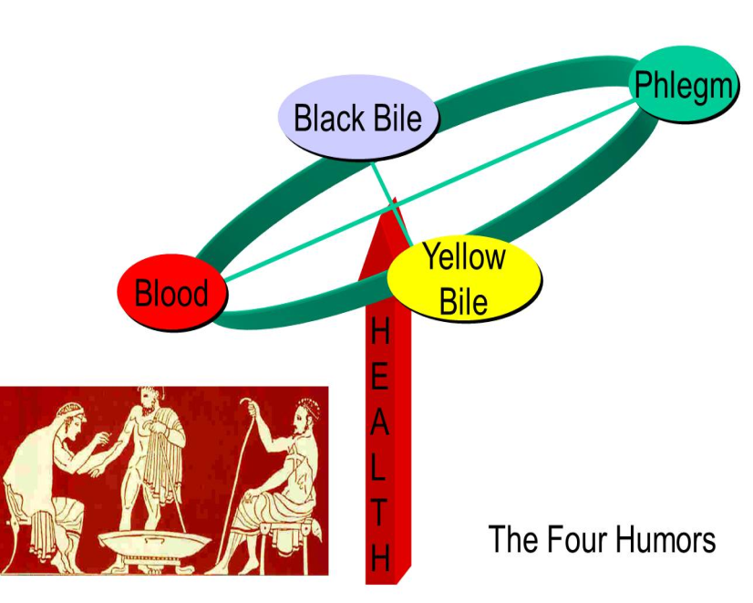
Historical development of diseases
4th Century BC: Hippocrates: Four Vital Humors
Historically, there have been many efforts to account for the occurrence of disease outcome. Religion often attributed disease outbreaks or other misfortunes to divine retribution – punishment for mankind’s sin
Hippocrates promoted the concept that disease is a result of an imbalance among four vital “humors” with us:
Yellow Bile
Black Bile
Phlegm
Blood
Caused by changes in season, air, wind,
water and stars

Slide 13
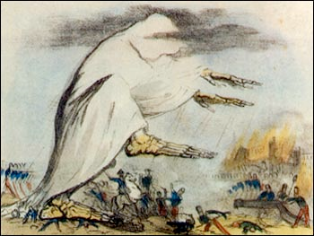
Miasmas (1800’s)
Disease rose from foul clouds low on earth’s surface
Miasmas were toxic vapors or gases that emerged from dirty pools or swamps or filth, and it was believed that if one inhale the vapors, disease would result

Slide 14
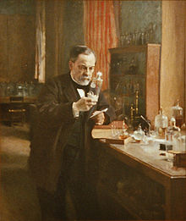
Germ Theory (1878)
Louis Pasteur and others introduced the Germ Theory in 1878
In 1890 Robert Koch proposed Specific Criteria that should be met before concluding that a disease was caused by a particular bacterium
Koch's Postulates criteria:
The bacteria must be present in every case of the disease.
The bacteria must be isolated from the host with the disease
and grown in pure culture.
The specific disease must be reproduced when a pure culture
of the bacteria is inoculated into a healthy susceptible host.
The bacteria must be recoverable from the experimentally
infected host

Slide 15
Limitations of Koch Postulate
Non communicable disease
One to one relation are rare biology
Disease production may require co-factors
Always it is not possible to isolate organism from diseased person
Viruses cannot be cultured like bacteria because they need living cells in which to grow.
Always infection does not produce disease
Pathogenic microbes may be present without clinical disease (sub-clinical infections, carrier states)

Slide 16
Webs of causation
The germ theory didn’t provide insights regarding the causes of chronic diseases, and over time it became increasingly apparent that for most diseases there were many contributory factors
Researchers began thinking about complex “Webs” of causation
Useful for understanding the causes on non-infectious diseases
Complex of web interconnected host and environmental, social and psychological factors
Illustrates the interconnectedness of possible causes
Causes of disease are interacting
Multiple causes and pathways of disease
Chain of causation

Slide 17
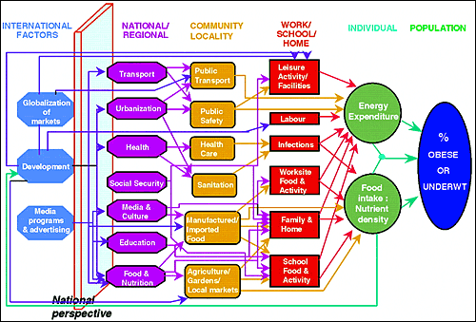
Web causation
A web of causation for obesity in the context of socio-ecologic perspective

Slide 18
Web of Causation
Phenotype
Social organization
Behaviour
Microbes
Disease
Environment
Genes
Workplace
Unknown factors

Slide 19
Epidemiologic Triad of disease (1920-1950s)
Disease is the result of forces within a dynamic system consisting of:
Agent of infection
Host
Environment
AGENT
DISEASE
HOST
ENVIRONMENT

Slide 20
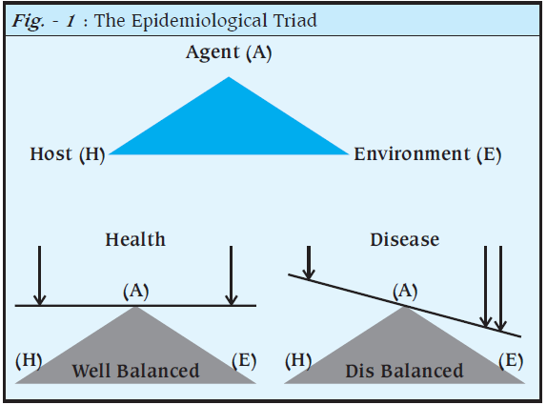
Epidemiological Triad

Slide 21
Classic Epidemiologic Theory
Agents
Living organisms
Exogenous chemicals
Genetic traits
Psychological factors and stress
Nutritive elements
Endogenous chemicals
Physical forces
Agents have characteristics such as infectivity, pathogenicity and virulence (ability to cause serious disease)
They may be transmitted to host via vectors

Slide 22
Classic Epidemiologic Theory
Host factor:
Immunity and immunologic response
Host behaviour
Environmental factors
Physical environment (heat, cold, moisture)
Biologic Environment (flora, fauna)
Social environment (economic, political, culture)

Slide 23
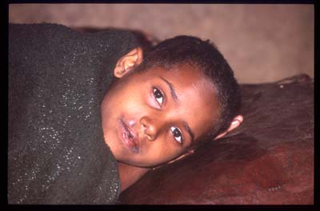
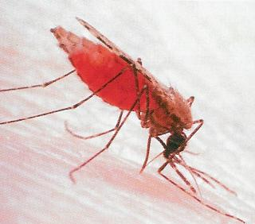
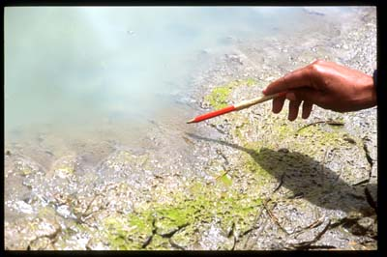
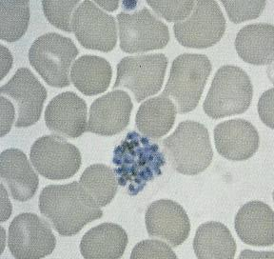
Malaria
Agent
Vector
Host
Environment

Slide 24
Era of Epidemiology
Era | Medical Paradigm | Preventative Approach
Sanitary | Miasma: Environmental pollutants | Drainage, sewage, sanitation
Infectious disease epidemiology | Germ theory: single agent for a single diseases | Vaccines, Isolations, quarantines & Antibiotics
Chronic disease epidemiology | Black box: exposure related to outcome without necessity for intervening factors or pathogenesis Multi-causal | Lifestyle & Environmental modification
Eco-Epidemiology | Societal perspective Globalisation Post genome | Inter govt agencies, fiscal and environmental policies Gene therapy

Slide 25
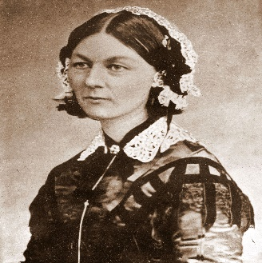
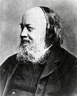
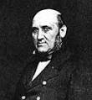
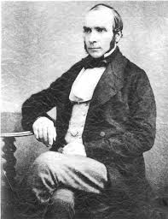
Era of epidemiology: The Sanitary era
Cause of disease at a societal level
Mechanism – Miasma
Setting up a system that routinely recorded the cause of death (Farr)
Foul emanations from soil, air and water
Solutions: Drainage, clean water supplies, sanitation
Nightingale
Edwin Chadwick
William Farr
John Snow

Slide 26
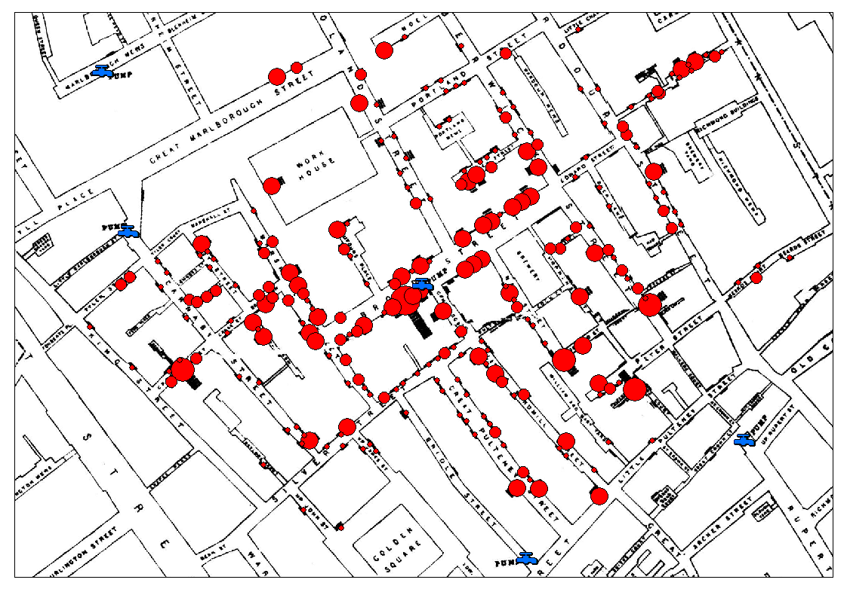
John Snow Discovery : Cholera outbreak
The Broad street cholera outbreak was a severe outbreak that occurred near Broad street (now renamed Broadwick street) in Soho district of London, England, 1854

Slide 27

Broadwick street showing the John Snow memorial and public house

Slide 28
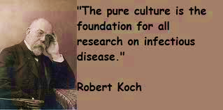
Infectious Disease Era (paradigm: Germ Theory)
Discovery of causal agent of Antrax, Tuberculosis & Cholera (by Robert Koch)
Vibro cholera (1854)
Bacillus Antrax (1877)
Mycobacterium Tuberculosis(1882)

Slide 29
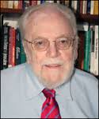
Risk factors Era (Paradigm: Black Box)
Web causation (Macmahon, 1960)
All factors are at the same level
Diseases can be preventable by cutting a few strands of the web
Does not elucidate societal forces or air related to health
Brian Macmahon

Slide 30
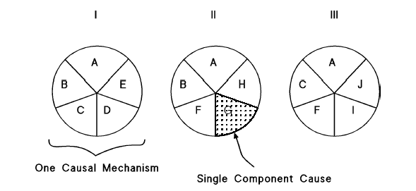
Causal Pie
Component causes (each slice of pie)
Necessary causes (A: in very pie, disease cannot occur without it)
Sufficient causes (a complete pie so disease will occur
Prevention: Remove at least one slice of the pie

Slide 31
Implications of the causal pie
The “Strength” of a component cause depends on the prevalence in the population of the other component causes in the causal mechanism
A factor will appear to have a strong effect if the other component causes are common in the population
A factor will appear to have a weak effect if the other component causes are rare in the population
No component cause/acts alone to produce disease
Every case of a disease is the result of multiple component causes acting jointly in a causal mechanism (“Pie”)
The sum of the fractions of a disease attributable to each of its causes does not equal to 100% but instead has no up limit

Slide 32
Cause
Why worry about Causes
So that we can intervene
So that we can reduce or prevent disease occurrence
Epidemiology Goal
To learn causes of diseases and factors that could prevent or delay disease development

Slide 33
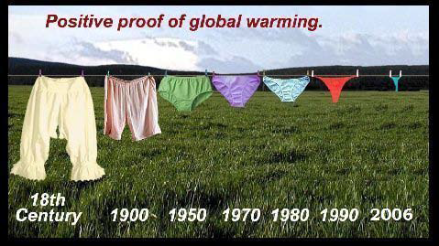
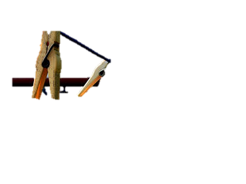
Cause & Effect

Slide 34
Definitions
Cause:
An event, condition or characteristic that preceded the disease event and without which the disease event would not have occurred at all or would not have occurred until some later time (Rothman & Greenland,1998)

Slide 35
Definitions (cont.)
Cause: is an event, condition, characteristic (or a combination)which plays an important role/ regular/ predicable change in occurrence of the outcome (e.g. smoking and lung cancer)
Cause may be “genetic” and or “environmental” (e.g. many NCDs including: diabetes, cancers etc)
Causal inference: A process of determining causal and preventive factors

Slide 36
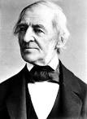
causality
Emerson’s view on causality
“Shallow men believe in luck.
Strong men believe in cause and effect”
Causality is in our psychological habit of witnessing effects that regularly followed causes in times and space (David Hume, 1772)
Ralph W.Emerson’s 1803-1882

Slide 37
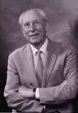

Causal thinking in health science
A determinant (of health) can be an factor, whether an event, characteristic, or other definable entity so long as it brings about change for better or for worse in a health condition.
Mervyn susser,1973
A factor is a causal of a certain disease when alterations in the frequency or intensity of this factor, without associated alterations in any other factor, are followed by changes in the frequency of occurrence of the disease, after the passage of a certain time period.
Pagona Lagiou,2005

Slide 38
Causal Relationships
A relationship is considered causal whenever evidence indicates that the factors form part of the complex circumstances which increase the probability of occurrence of disease and that a reduction of one or more of these factors decreases the frequency of disease
Causal pathway may be Direct or Indirect

Slide 39
Causal relationship
Direct causation, X causes Y without intermediate effects
Factor
Disease
Exposure to the risk factor causes disease directly
Indirect causation, X causes Y, but with intermediate effects (I causes X, which in turn causes Y
Factor
Step 1
Step 2
Disease
Exposure influences intermediate factor (intervening variable) which in turn cause disease
In human biology, intermediate steps are virtually always present in any causal process

Slide 40
Direct vs Indirect Causation
Direct
Indirect
Δ F508 Polymorphism
High Cholesterol
Artery thickening
Hemostatic factor
Cystic Fibrosis
Myocardial infarction

Slide 41
Direct causation
One-to-one causal association
X causes Y (e.g. Rubeola virus Measles)
Multifactorial causation
Sufficient and necessary cause
Web causation
Multiple factor leads to the diseases
Common in non-communicable diseases
Smoking
Reaction at cellular level
Lung cancer
Air pollution
Exposure to Asbestos

Slide 42
Multifactorial causation
Exposure to Asbestos | History of tobacco use | Lung cancer death rate per 100 000
No | No | 11
Yes | No | 58
No | Yes | 123
Yes | Yes | 602
Age-standardized lung cancer deaths rates (per 100 000 population) in relation to tobacco use and occupational exposure to asbestos dust

Slide 43
Types of causal relationship
Sufficient and but not Necessary: The factor alone can cause disease, but so can other factors in its absence
Benzene or radiation can cause leukemia without the presence of the other factor
Neither sufficient nor necessary (supporting component cause: the factor cannot cause disease on its own, no is it the only factor can cause that disease
This is the probable model for chronic disease relationships
Necessary causes + component causes = Sufficient cause

Slide 44
Types of causal relationship
Necessary and Sufficient: without the factor disease never develops
With the factor, disease always develops (this situation rarely occurs)
Necessary but not sufficient: the factor in and of itself is not enough to cause disease
Multiple factors are required, usually in a specific temporal sequence (such as carcinogenesis)

Slide 45
Sufficient & Necessary cause
A,B,C,N – known components (causes)
U – unknown component (cause)
N - necessary cause
A
B
U
C
N
known component + unknown component cause + necessary cause = sufficient cause

Slide 46
Example: causes of TB
Exposure to bacteria
Tissue invasion
Genetic factors
Malnutrition
Susceptible Host
Infection
TB
Crowded housing
Immune-
suppression
Poverty
Risk factors for TB
Mechanisms for TB

Slide 47
There may be number of sufficient causes for single disease in various combination of component causes, necessary causes
A
A
A
B
D
B
U
U
U
E
C
C
N
N
N
DISEASE

Slide 48
Factors in Causation
All may be necessary but rarely sufficient to cause a particular disease or state
Predisposing: age, gender, or previous illness may create a state of susceptibility to a disease agent
Enabling: low income, poor nutrition bad housing or inadequate medical care may favour the development of disease
Conversely, circumstances that assist in recovery or in health maintenance may be enabling
Precipitating: exposure to a disease or noxious agent
Reinforcing: repeated exposure or undue work or stress may aggravate an established disease or state

Slide 49
How to establish the cause of a disease?
OBSERVED ASSOCIATION?
Could it be due to selection or measurement bias?
NO
Could it be due to confounding?
NO
Could it be a result of chance?
Probably Not
Could it be causal?
Apply Bradford-Hills guidelines and make judgement

Slide 50
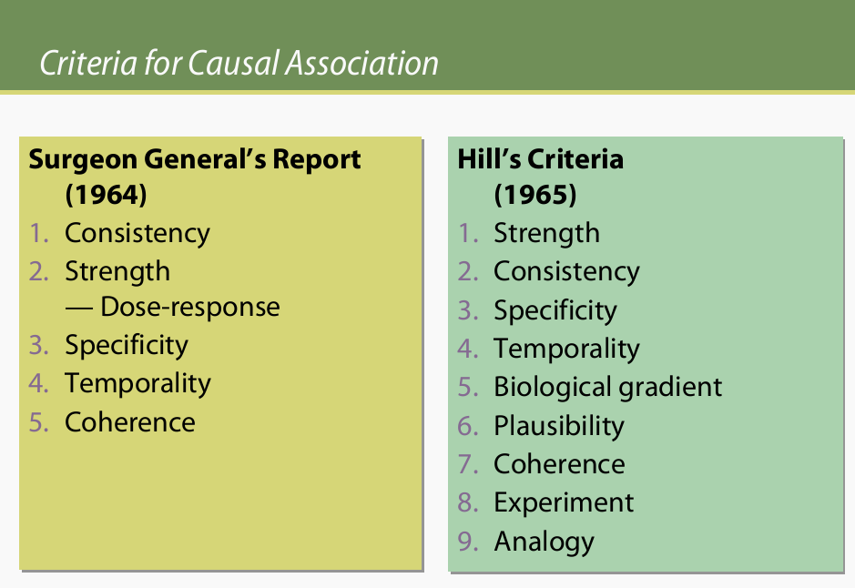

Slide 51
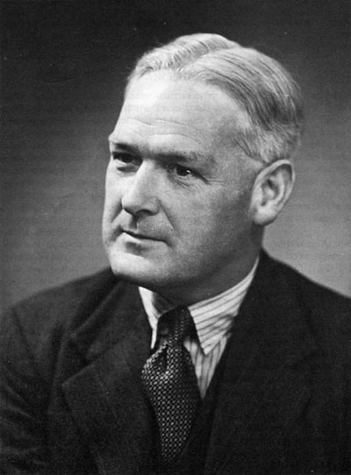
Bradford-Hill’s Criteria(1897-1991)
The first complete statement of the epidemiologic criteria of a causality is attributed to Austin Hill (1897-1991)
Consistency (on replication)
Strength (of association)
Specificity
Dose response relationship
Temporal relationship (directionality)
Biological plausibility (evidence)
Coherence
Experiment
Analogy

Slide 52
Applying guidelines (Hills criteria/Guidelines for causation) and making judgment regarding causation
Consistency | Have similar result been shown in other studies?
Plausibility | Is the association consistent with other knowledge? (mechanism of action; evidence from experimental animals
Temporal relationship | Does the cause precede the effect? (essential)
Strength | What is the strength of the association between the cause and effect? (Relative Risk)
Dose response relationship (Biological gradient) | Is increased exposure to the possible cause associated with increased effect?
Reversibility | Does the removal of possible cause lead to reduction of disease risk?
Study design | Is the evidence based on a strong study design?
Judging the evidence | How many lines of evidence lead to the conclusion

Slide 53
1. Consistency
Is the same association found in many studies?
Different persons in Different places, in Different circumstances & Times by Different method (by various types of studies) is established the Same result by several studies
Example:
Cigarette smoking and lung cancer
Over 50 respective studies and at least 9 prospective studies have shown the association

Slide 54
1. Consistency
Meta-analysis is an good method for testing consistency
It summarizes odds ratios from various, excludes bias
Consistency could either mean:
Exact replication (as lab sciences, impossible in epidemiological studies)
Replication under similar circumstances (possible)

Slide 55
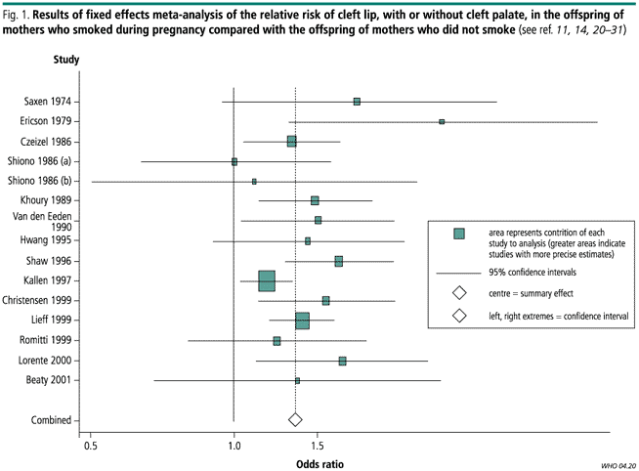
Little J., 2004. Tobacco smoking and oral cleft: meta-analysis

Slide 56
2. Strength of Association
Is the Association Strong? Measured by
Effect measure (Rate ratio, Risk ratio or Odds Ratio)
Away from unity (the higher, the stronger the association
The stronger the association the more likely it is to be truly causal
Less likely to be due to confounding or bias (known or unknown confounders)
Weak association may be causal
Measurement error dilutes association
P-value (95% Confidence level): less than 0.05 (the smaller, the stronger the association

Slide 57
Strength of Association
Risk Ratio | Interpretation
< 1 | Protective
0.9 – 1.1 | No Association
1.2 – 1.6 | Weak Causal Association
1.7 – 2.5 | Moderate Causal Association
> 2.6 | Strong Causal Association

Slide 58
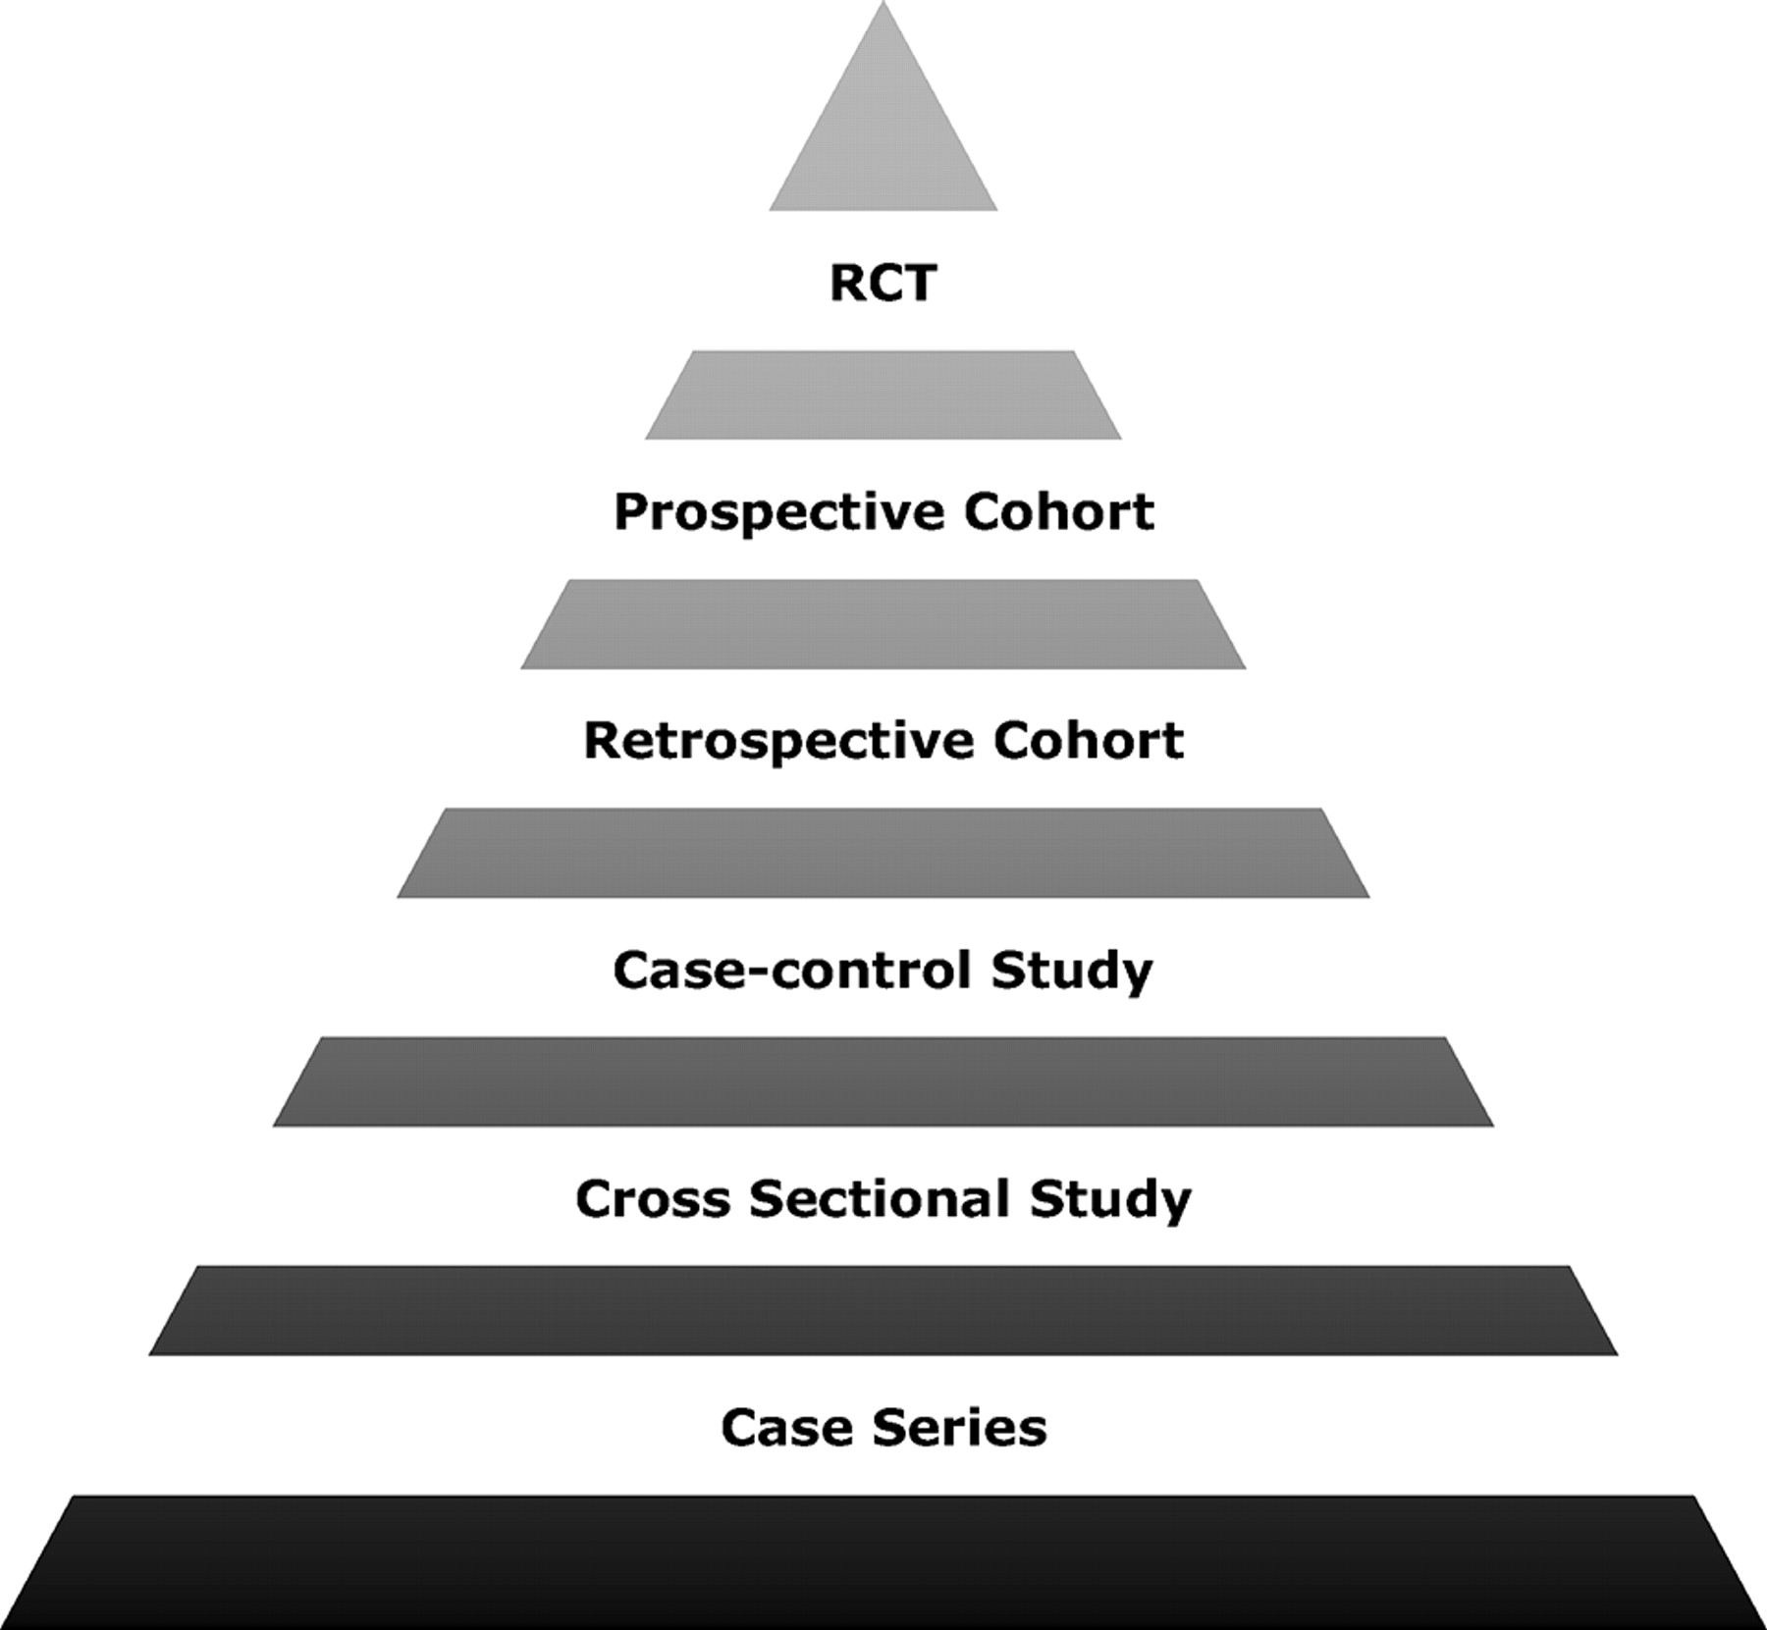
Figure. The pyramid of evidence.
Filtered Information
Systematic Review & Meta Analysis
Unfiltered Information
Validity/quality of evidence
Expert opinions, editorials, Ideas
Michael Ho et al. Circulation. 2008;118:1675-1684 & M Hassan Murad et al. Evid Based Med doi:10.1136/ebmed-2016-110401
Notes:
Figure. The pyramid of evidence.

Slide 59
3. Specificity
Occurs when a single factor is associated with a single outcome
One to one association
Weakest of all guidelines: Increasingly irrelevant to current models of disease causation
Single factor may have many outcomes
E.g. smoking is a causal of Ca in: lung, oral cavity, larynx, kidney, Oesophagus

Slide 60
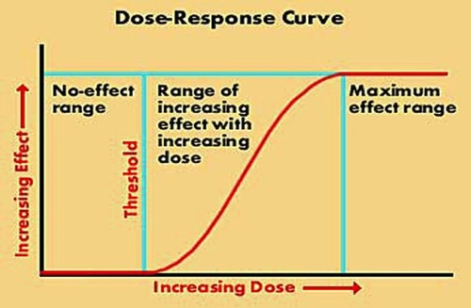
4. Dose-Response Relationship (The Biological Gradient)

Slide 61
4. Dose-Response Relationship (The Biological Gradient)
Death rates from lung cancer (per 1000) by number of cigarettes smoked, British male doctors, 1951 –1961

Slide 62
4. Dose-Response Relationship (The Biological Gradient)
As level of exposure increases, the risk of disease increases
Observed an increase in the magnitude of risk of outcome with the magnitude of exposure
Unlikely to be explained by bias or undetected confounding
But liver cirrhosis shows strong dose relationship with smoking probably confounded by alcohol
Lack of biological gradient does not rule out causality
Threshold effect
J or U shaped relationship e.g. alcohol

Slide 63
5. Temporal relationship (Directionality)
The relationship with Time (Time Order) and Direction
Drinking contaminated water Occurrence of diarrhoea
However many chronic cases, because of insidious onset and ignorance of precise induction period, it become hard to establish a temporal sequence as which comes first – the suspected agent or the disease
Cause must precede the effect(essential)

Slide 64
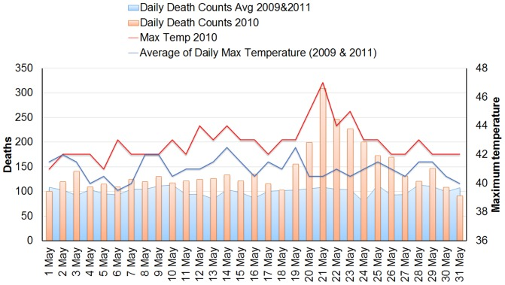
5. Temporal relationship (Relationship with Time)
Azhar G.S,. et al, (2014) Heat-Related Mortality in India: Excess All-Cause Mortality Associated with the 2010 Ahmedabad Heat Wave, PLOS one Vol.9, issue 3

Slide 65
6. Biological plausibility
Consistency with biological knowledge of the day
Smoking causing lung cancer
Smoking causes skin cancer?
Lack of plausibility may simply reflect lack of scientific knowledge

Slide 66
7. Coherence
Cause and effect relationship does not conflict with known natural history and biology of disease
Theoretical: Compatible with pre-existing theory
Factual: compatible with pre-existing knowledge
Biological: compatible with current biological knowledge from other species or other level of organisation
Statistical: compatible with a reasonable statistical model (e.g. dose-response)
Correct temporal relationship is essential; then greatest weight may be given to plausibility, consistency and the dose-response relationship. The likelihood of a causal association is heightened when many different types of evidence leading to the same conclusion

Slide 67
8. Experiment
RCT, the “Gold Standard” for determining causal association
Reversibility: Removal of exposure leads to a reduction in the risk of the outcome

Slide 68
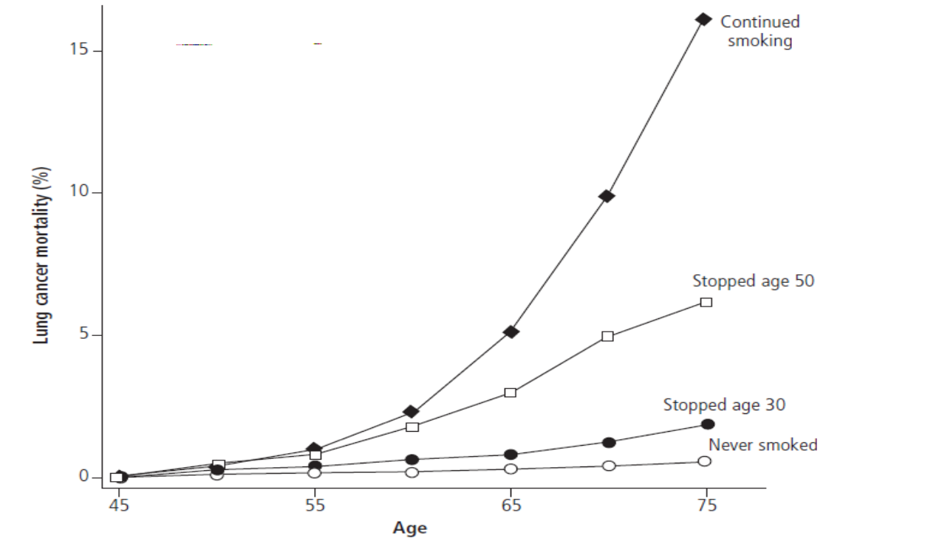
8. Experiment: Removal (Reversibility)
Stopping works: cumulative risk of lung cancer mortality

Slide 69
9. Analogy
Judging by Analogy
Similarities between observed association and other associations

Slide 70
DERIVING CAUSAL INFERENCES: EXAMPLE
Until the 1980s, the major causes of peptic ulcer disease were considered to be stress and lifestyle factors, including smoking
In 1984, Australian physicians Drs. Barry J. Marshall and J. Robin Warren reported that they had observed small curved bacteria colonizing the lower part of the stomach in patients with gastritis and peptic ulcers
After several attempts, Marshall succeeded in cultivating a hitherto unknown bacterial species (later named Helicobacter pylori) from several of these biopsies

Slide 71
He drank a Petri dish containing cultured H. pylori, expecting to develop, perhaps years later, an ulcer. He was surprised when, only three days later, he developed vague nausea and halitosis
Together they found that the organism was present in almost all patients with gastric inflammation or peptic ulcer
Many of these patients had biopsies performed which showed evidence of inflammation present in the gastric mucosa close to where the bacteria were seen
Based on these results, they proposed that Helicobacter pylori is involved in the etiology of these diseases. It was subsequently shown that the ulcer was often not cured until Helicobacter pylori had been eliminated.

Slide 72
Assessment of the Evidence Suggesting Helicobacter pylori as a Causative Agent of Duodenal Ulcers
1. Temporal relationship
Helicobacter pylori is clearly linked to chronic gastritis. About 11% of chronic gastritis patients will go on to have duodenal ulcers over a 10-year period.
2. Strength of the relationship
Helicobacter pylori is found in at least 90% of patients with duodenal ulcer.
In at least one population reported to lack duodenal ulcers, a northern Australian aboriginal tribe that is isolated from other people, it has never been found.

Slide 73
3. Dose-response relationship
Density of Helicobacter pylori per square millimeter of gastric mucosa is higher in patients with duodenal ulcer than in patients without duodenal ulcer
4. Replication of the findings
Many of the observations regarding Helicobacter pylori have been replicated repeatedly
5. Consideration of alternate explanations
Data suggest that smoking can increase the risk of duodenal ulcer in Helicobacter pylori-infected patients but is not a risk factor in patients in whom Helicobacter pylori has been eradicated

Slide 74
6. Biologic plausibility
Although originally it was difficult to envision a bacterium that infects the stomach antrum causing ulcers in the duodenum, it is now recognized that Helicobacter pylori has binding sites on antral cells and can follow these cells into the duodenum.
Helicobacter pylori also induces mediators of inflammation.
Helicobacter pylori-infected mucosa is weakened and is susceptible to the damaging effects of acid.
7. Cessation of exposure
Eradication of Helicobacter pylori heals duodenal ulcers at the same rate as histamine receptor antagonists.
Long-term ulcer recurrence rates were zero after Helicobacter pylori was eradicated using triple-antimicrobial therapy, compared with a 60% to 80% relapse rate often found in patients with duodenal ulcers treated with histamine receptor antagonists.

Slide 75
8. Specificity of the association
Prevalence of Helicobacter pylori in patients with duodenal ulcers in 90% to 100%. However, it is found in some patients with gastric ulcer and even in asymptomatic individuals.
9. Analogy (Consistency with other knowledge)
Prevalence of Helicobacter pylori infection is the same in men as in women. The incidence of duodenal ulcer, which in earlier years was believed to be higher in men than in women, has been equal in recent years.
The prevalence of ulcer disease is believed to have peaked in the latter part of the 19th century, and the prevalence of Helicobacter pylori may have been much higher at that time because of poor living conditions.

Slide 76
Causal Criteria of Bradford-Hills
Criteria | Problems with the criteria
Strength | Strength depends on the prevalence of other causes and, thus, is not a biologic characteristic; could be confounded.
2. Consistency | Exceptions are understood best with hindsight.
3. Specificity | A cause may have many effects.
4. Temporality | It may be difficult to establish the temporal sequence between cause and effect.
5. Dose response relationship (Biological gradient) | Could be confounded; threshold phenomena would not show as progressive relation.
6. Plausibility | Too objective.
7. Coherence | How does it differ from consistency or plausibility?
8. Experimental evidence | Not always available.
9. Analogy | Analogies abound.

Slide 77
Comparing Rules of Evidence
Criminal Law | Causation
Criminal present at scene of crime | Agent present in the disease
Premeditation | Causal events precede onset of disease
Accessories involved in the crime | Co-factors and/or multiple causality involved
Severity of crime to state of victim | Susceptibility and host response determine severity
Motivation –there must be gain to the criminal | The role of the agent in the disease must make biologic and common sense
No other suspect could have committed the crime | No other agent could have cause disease under the circumstances given
Proof of guilty must be established beyond a reasonable doubt | Proof of causation must be established beyond reasonable doubt or role of chance

Slide 78
Analytical Methods
Measures of association / strength of association
Testing hypothesis of association
Controlling confounders

Slide 79
Testing hypothesis of Association
Null Hypothesis
Rejecting
Accepted
Causal association
No causal association

Slide 80
Controlling confounders
At Time designing of epidemiological study or while carrying study
Randomisation
Restriction
Matching
At Analysis Stage
Stratification
Adjustment
Statistical modelling

Slide 81
Measure of association / strength of association
Ratio measures
Relative risk
Odds ratio
Difference measures
Attributable risk
Population Attributable risk

Slide 82

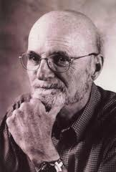
“The world is Richer with Associations than Meanings, and it’s the part of wisdom to differentiate the two”
John Barth (novelist

Slide 83
References
Hill AB. The environment and disease: Association or Causation? Proc R. Soc.Med.1965;58:295-300
Susser MW. What is a cause and how do we know one? A grammar for pragmatic Epidemiology. American Journal 1991;133:635-648
Gordis L. Epidemiology (2009) (4th Ed) chapter 14: From Association to causation: Deriving Inferences from Epidemiologic studies
Beaglehole R, Bonita R., (2006) Basic Epidemiology. Delhi: AITBS publisher & Distributor
Last J., A dictionary ofEpidemiology, 4th Ed.
Galea S, et al.,Causal thinking & Complex sytem approach in epidemiology. International Journal of Epidemiology, 2010 Feb; 39 (1):97-106
Rothman KJ, Greenlan S,et al., Modern Epidemiology. 3rd Ed. New Delhi

